Slide 1
Matrix Profile Proposal
Application of Matrix Profile method on building energy datasets to perform
semi real-time anomaly detection and motif/discord discovery
30 April 2021
PhD Candidate: Roberto Chiosa
Supervisor: Prof. Alfonso Capozzoli
Co-Supervisor: Prof. Cheng Fan

Slide 2
Problem Statement
All-pairs similarity search: ﻿Given a collection of data objects, retrieve the nearest neighbour for each object
1 data/minute + 1 year of measurement = TS of length 525,600.
The obvious nested loop algorithm requires 132,880,692,960 Euclidean distance computations. If we assume each one takes 0.0001 seconds, then the join will take 153.8 days.
This problem is usually addressed with dimensionality reduction techniques PAA and SAX. The core contribution of Matrix Profile is to show that we can reduce this time to 6.3 hours, using an off-the-shelf desktop computer without dimensionality reduction and information loss.

Slide 3
Matrix Profile: Properties
﻿It is exact: the Matrix Profile based methods provide no false positives or false dismissals. It can handle missing data: Even in the presence of missing data, we can provide answers which are guaranteed to have no false negatives.
It is simple and parameter-free: In contrast, the more general algorithms in this space that typically require building and tuning spatial access methods and/or hash functions.
It is space efficient: Matrix Profile construction algorithms requires an inconsequential space overhead, just linear in the time series length with a small constant factor, allowing massive datasets to be processed in main memory (for most data mining, disk is death).
It is incrementally maintainable: Having computed the Matrix Profile for a dataset, we can incrementally update it very efficiently. In many domains this means we can effectively maintain exact joins/motifs/discords on streaming data forever. MP is extremely scalable, for extremely large datasets we can compute the Matrix Profile in an anytime fashion, allowing ultra-fast approximate solutions and real-time data interaction.
Simplicity and Intuitiveness: Seeing the world through the MP lens often invites/suggests simple and elegant solutions.
It can be constructed in deterministic time: given only the length of the time series, we can precisely predict in advance how long it will take to compute the Matrix Profile. (this allows resource planning)
It can leverage hardware: Matrix Profile construction is embarrassingly parallelizable, both on multicore processors, GPUs, distributed systems etc.

Slide 4
Matrix Profile: Definitions
﻿Definition 1: A time series T ∈ ℝ^{n} is a sequence of real-valued numbers t_{i} ∈ ℝ : T = {t₁,t₂ … t_{n}} , where n is the length of T
﻿Definition 2: A subsequence T_{i,m} ∈ ℝ^{m} is a continuous subset of values from T of length m starting from position i. Formally defined as t_{i} ∈ ℝ : T_{i,m} = {t_{i},t_{i+1} … t_{i+m-1}}
Definition 3: A distance profile D is a vector of the Euclidean distances between a given query and each subsequence in an all subsequence length. In the original matrix profile formulation ﻿is assumed that the distance is measured using the Euclidean distance between the z-normalized subsequences
Definition 4: An all-subsequences set A of a time series T is an ordered set of all possible subsequences of T obtained by sliding a window of length m across T : A = {T_{1,m} , T_{2,m} … T_{n-m+1,m}} where m is a user-defined subsequence length. We use A[i] to denote T_{i,m}
Definition 5: Given two all-subsequences sets A and B and two subsequences A[i] and B[j], a 1NN-join function θ_{1NN}(A[i], B[j]) is a Boolean function which returns “true” only if B[j] is the nearest neighbor of A[i] in the set B.
Definition 6: Given all-subsequences sets A and B, a similarity join set J_{AB} of A and B is a set containing pairs of each subsequence in A with its nearest neighbor in B : J_{AB} = {〈 A[i], B[j] 〉 | θ_{1NN}(A[i], B[j]). We denote this formally as J_{AB}=A⋈ _{θ1NN} B.
Definition 7: A matrix profile (or just profile) P_{AB} is a vector of the Euclidean distances between each pair in J_{AB} . We call this vector the matrix profile because one (inefficient) way to compute it would be to compute the full distance matrix of all the subsequences in one time series with all the subsequence in another time series and extract the smallest value in each row (the smallest non-diagonal value for the self-join case).
Definition 9: The i^{th} element in the matrix profile tells us the Euclidean distance to the nearest neighbor of the subsequence of T, starting at i. However, it does not tell us where that neighbor is located. This information is recorded in matrix profile index. A matrix profile index I_{AB} of a similarity join set J_{AB} is a vector of integers where I_{AB}[i] = j if {A[i], B[j]} ∈ J_{AB}

Slide 5
Matrix Profile Example
An example of MP calculation on a simple Time Series

Slide 6
0
1
3
2
9
1
14
15
1
2
2
10
7
14
12
10
8
6
4
2
0

Slide 7
0
1
3
2
9
1
14
15
1
2
2
10
7
14
12
10
8
6
4
2
0
T = {t₁,t₂ … t_{n}} = {0,1,3,4,9,1,14,15,1,2,2,10,7}, n = 13

Slide 8
t_{i=1}
0
1
3
2
9
1
14
15
1
2
2
10
7
14
m = 4
12
10
8
6
T_{1,m} = {t_{i},t_{i+1} … t_{i+m-1}}
= {0,1,3,4}
4
2
0
T = {t₁,t₂ … t_{n}} = {0,1,3,4,9,1,14,15,1,2,2,10,7}, n = 13

Slide 9
0
1
3
2
9
1
14
15
1
2
2
10
7
t_{i=1}
0
1
3
2
9
1
14
15
1
2
2
10
7
14
m = 4
12
10
8
6
T_{1,m} = {t_{i},t_{i+1} … t_{i+m-1}}
= {0,1,3,4}
4
2
0
T = {t₁,t₂ … t_{n}} = {0,1,3,4,9,1,14,15,1,2,2,10,7}, n = 13

Slide 10
D_{z-normalized}
0
1
3
2
9
1
14
15
1
2
2
10
7
D_{euclidean}
t_{i=1}
0
1
3
2
9
1
14
15
1
2
2
10
7
14
m = 4
12
10
8
6
T_{1,m} = {t_{i},t_{i+1} … t_{i+m-1}}
= {0,1,3,4}
4
2
0
T = {t₁,t₂ … t_{n}} = {0,1,3,4,9,1,14,15,1,2,2,10,7}, n = 13

Slide 11
0
D_{z-normalized}
0
Trivial match
0
1
3
2
9
1
14
15
1
2
2
10
7
D_{euclidean}
0
1
3
2
9
1
14
15
1
2
2
10
7
14
12
10
8
6
4
2
0
i=1

Slide 12
0
2.0
D_{z-normalized}
0
7.4
0
1
3
2
9
1
14
15
1
2
2
10
7
D_{euclidean}
0
1
3
2
9
1
14
15
1
2
2
10
7
14
12
10
8
6
4
2
0
i=2

Slide 13
0
2.0
1.5
D_{z-normalized}
0
7.4
6.9
0
1
3
2
9
1
14
15
1
2
2
10
7
D_{euclidean}
0
1
3
2
9
1
14
15
1
2
2
10
7
14
12
10
8
6
4
2
0
i=3

Slide 14
0
2.0
1.5
2.4
D_{z-normalized}
0
7.4
6.9
14.7
0
1
3
2
9
1
14
15
1
2
2
10
7
D_{euclidean}
0
1
3
2
9
1
14
15
1
2
2
10
7
14
12
10
8
6
4
2
0
i=4

Slide 15
0
2.0
1.5
2.4
1.4
D_{z-normalized}
0
7.4
6.9
14.7
19.3
0
1
3
2
9
1
14
15
1
2
2
10
7
D_{euclidean}
0
1
3
2
9
1
14
15
1
2
2
10
7
14
12
10
8
6
4
2
0
i=5

Slide 16
0
2.0
1.5
2.4
1.4
1.8
D_{z-normalized}
0
7.4
6.9
14.7
19.3
17.7
0
1
3
2
9
1
14
15
1
2
2
10
7
D_{euclidean}
0
1
3
2
9
1
14
15
1
2
2
10
7
14
12
10
8
6
4
2
0
i=6

Slide 17
0
2.0
1.5
2.4
1.4
1.8
3.4
D_{z-normalized}
0
7.4
6.9
14.7
19.3
17.7
19.9
0
1
3
2
9
1
14
15
1
2
2
10
7
D_{euclidean}
0
1
3
2
9
1
14
15
1
2
2
10
7
14
12
10
8
6
4
2
0
i=7

Slide 18
0
2.0
1.5
2.4
1.4
1.8
3.4
3.2
D_{z-normalized}
0
7.4
6.9
14.7
19.3
17.7
19.9
15.0
0
1
3
2
9
1
14
15
1
2
2
10
7
D_{euclidean}
0
1
3
2
9
1
14
15
1
2
2
10
7
14
12
10
8
6
4
2
0
i=8

Slide 19
0
2.0
1.5
2.4
1.4
1.8
3.4
3.2
2.0
D_{z-normalized}
0
7.4
6.9
14.7
19.3
17.7
19.9
15.0
8.2
0
1
3
2
9
1
14
15
1
2
2
10
7
D_{euclidean}
0
1
3
2
9
1
14
15
1
2
2
10
7
14
12
10
8
6
4
2
0
i=9

Slide 20
0
2.0
1.5
2.4
1.4
1.8
3.4
3.2
2.0
0.6
D_{z-normalized}
0
7.4
6.9
14.7
19.3
17.7
19.9
15.0
8.2
8.9
0
1
3
2
9
1
14
15
1
2
2
10
7
D_{euclidean}
0
1
3
2
9
1
14
15
1
2
2
10
7
14
12
10
8
6
4
2
0
i=10

Slide 21
0
2.0
1.5
2.4
1.4
1.8
3.4
3.2
2.0
0.6
D_{z-normalized}
0
7.4
6.9
14.7
19.3
17.7
19.9
15.0
8.2
8.9
0
1
3
2
9
1
14
15
1
2
2
10
7
D_{euclidean}
0
1
3
2
9
1
14
15
1
2
2
10
7
14
12
10
8
6
4
2
0

Slide 22
Trivial match
0
2.0
1.5
2.4
1.4
1.8
3.4
3.2
2.0
0.6
0
Full distance matrix
0
0
0
0
0
0
0
0

Slide 23
Trivial match
0
2.0
1.5
2.4
1.4
1.8
3.4
3.2
2.0
0.6
0
Full distance matrix
0
0
0
0
0
0
0
Nearest neighbour
0

Slide 24
Matrix profile
Trivial match
0
2.0
1.5
2.4
1.4
1.8
3.4
3.2
2.0
0.6
0
0,3
Full distance matrix
0
1.6
0
1.1
0
1.3
0
1.8
0
3.0
0
2.8
0
0.3
Nearest neighbour
0
0.6

Slide 25
Matrix profile
14
0.6
12
10
0,3
8
1.6
6
1.1
4
Matrix profile
2
1.3
0
1.8
3
3.0
2
2.8
0.3
1
0.6
0

Slide 26
14
12
10
8
6
4
Matrix profile
2
0
3
2
LOW VALUE
Conserved subsequence
1
0

Slide 27
14
12
10
8
6
4
Matrix profile
2
0
HIGH VALUE
Discord subsequence
3
2
LOW VALUE
Conserved subsequence
1
0

Slide 28
14
12
1st NN
(Identified through matrix profile index)
10
8
6
4
Matrix profile
2
0
3
2
LOW VALUE
Conserved subsequence
1
0

Slide 29
Matrix Profile Application
A case study of MP on building energy dataset. Limits and possible improvements

Slide 30
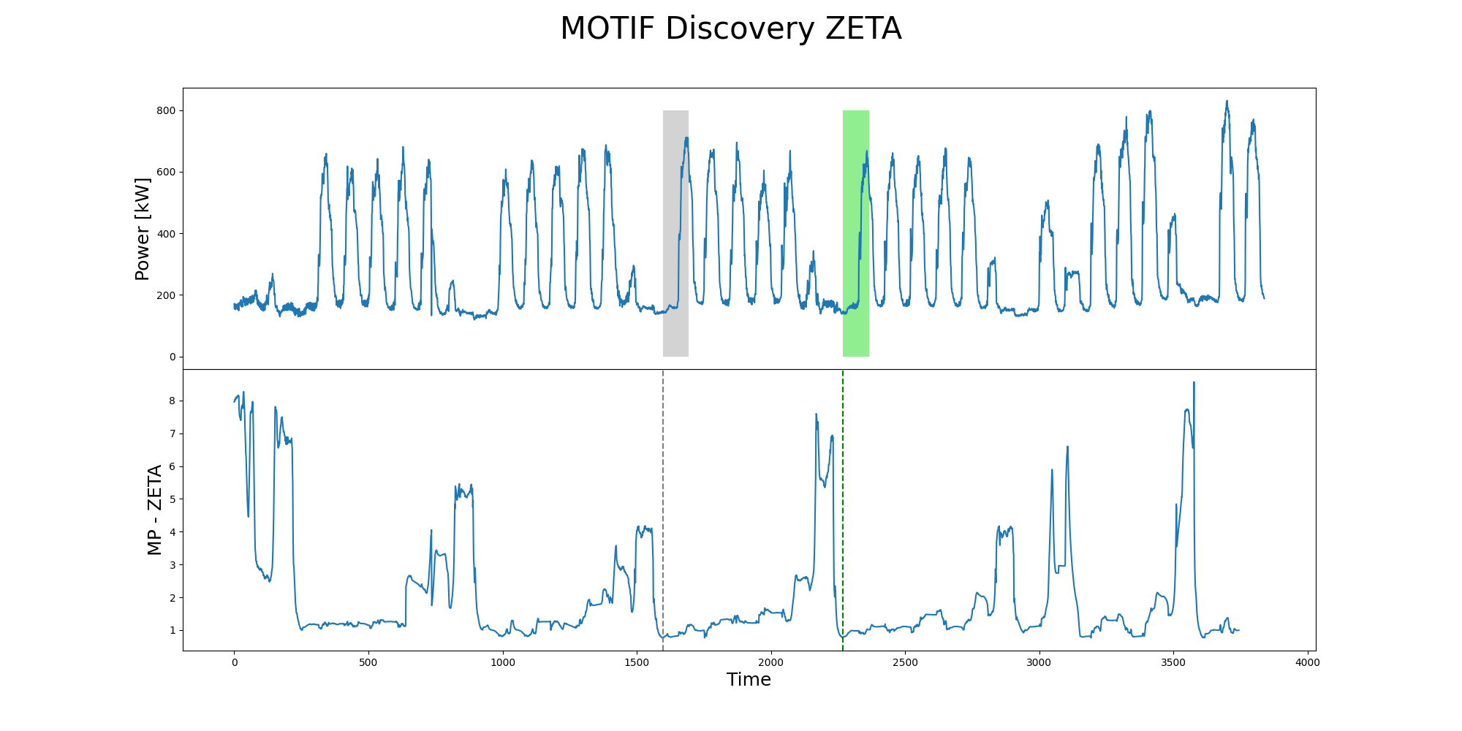
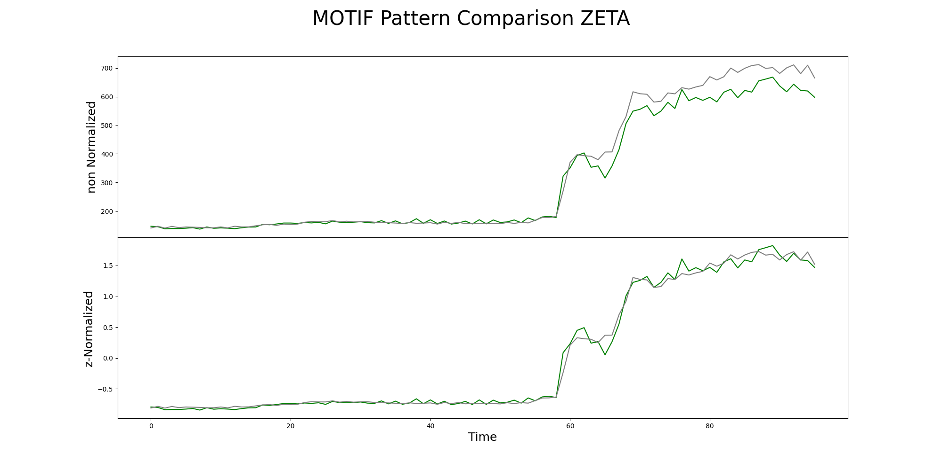
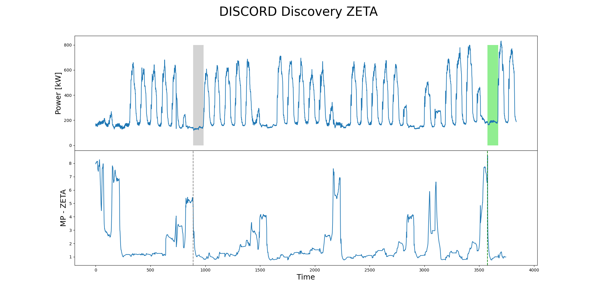
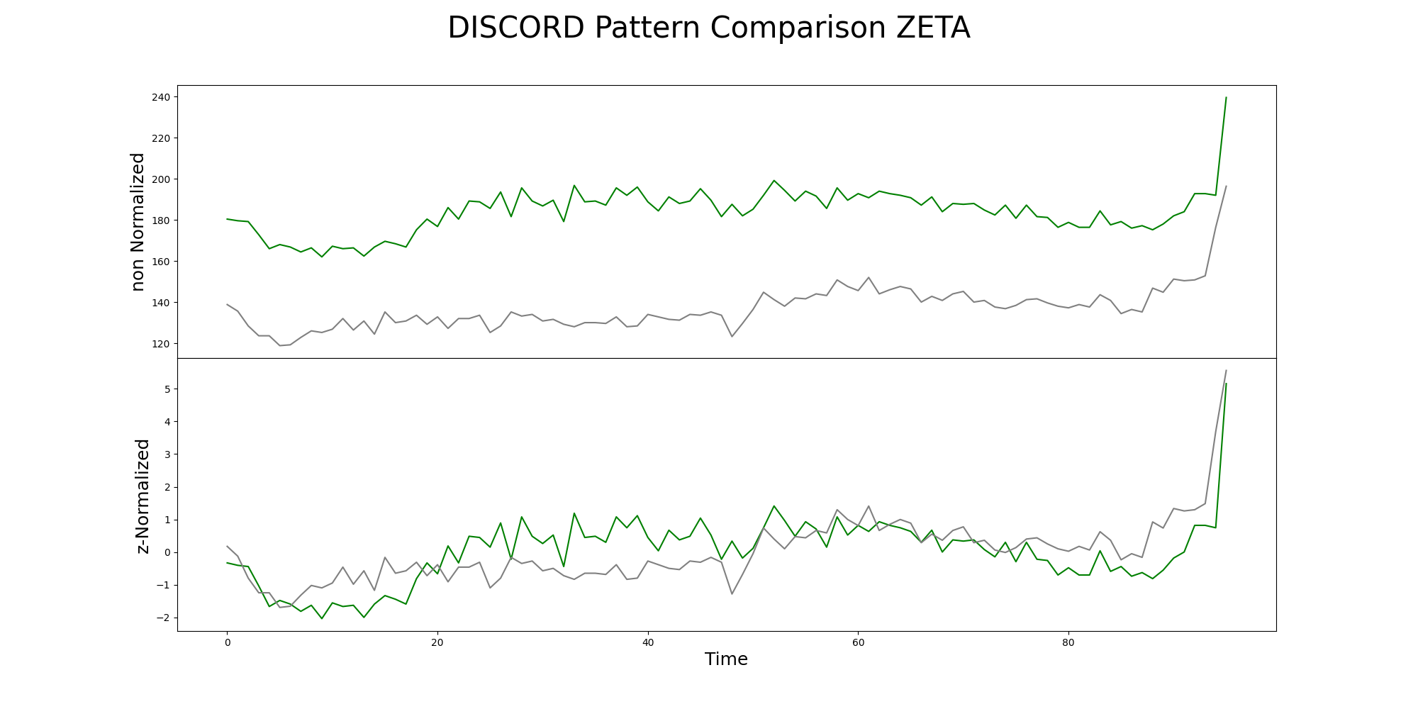
m = 96, n = 3765
T_{i,m}
1st NN

Slide 31
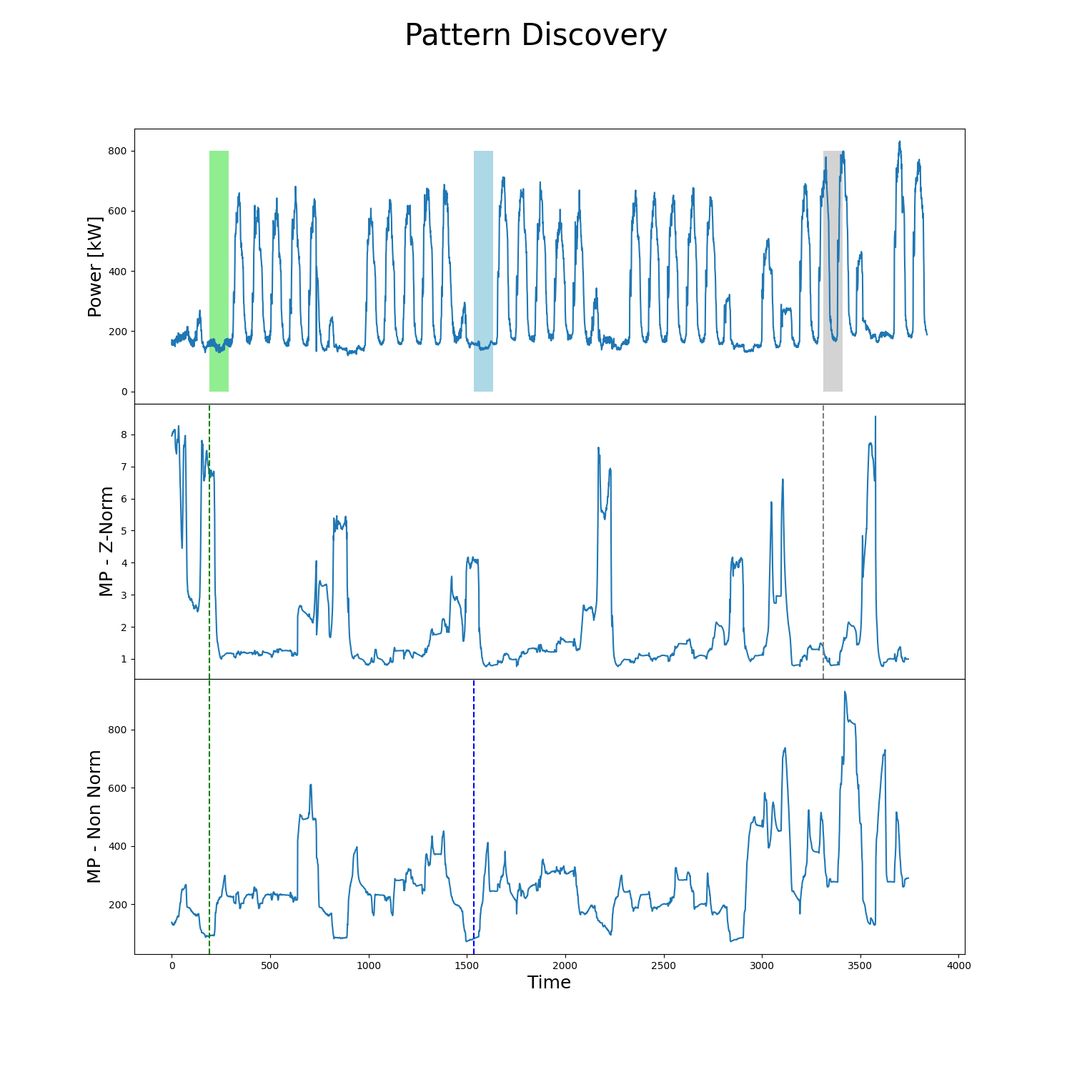
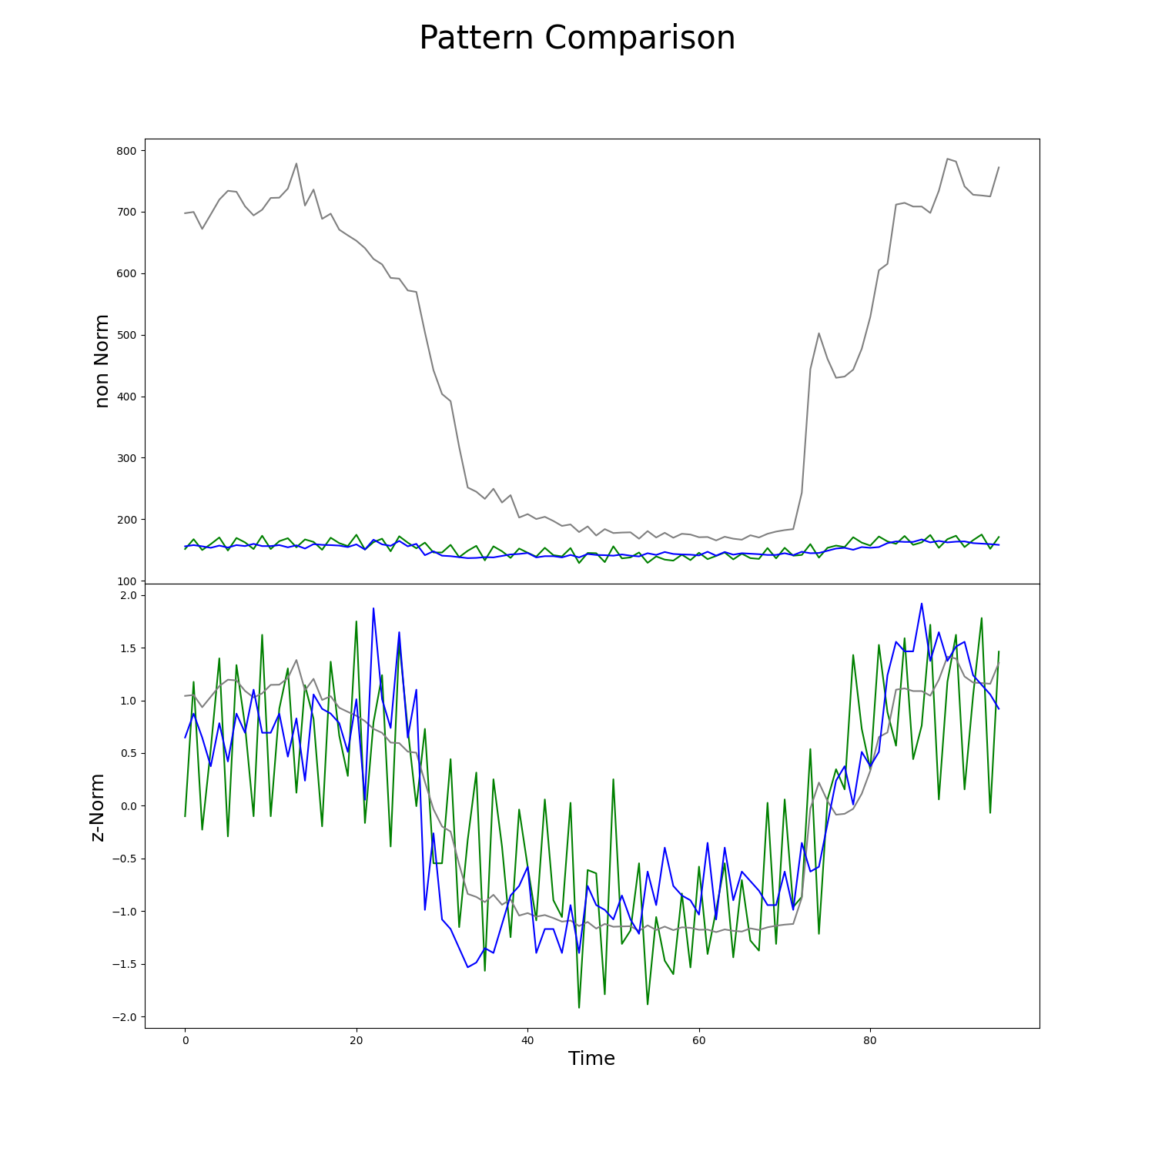
m = 96, n = 3765
T_{i,m}
1st NN z-score
1st NN euclid

Slide 32
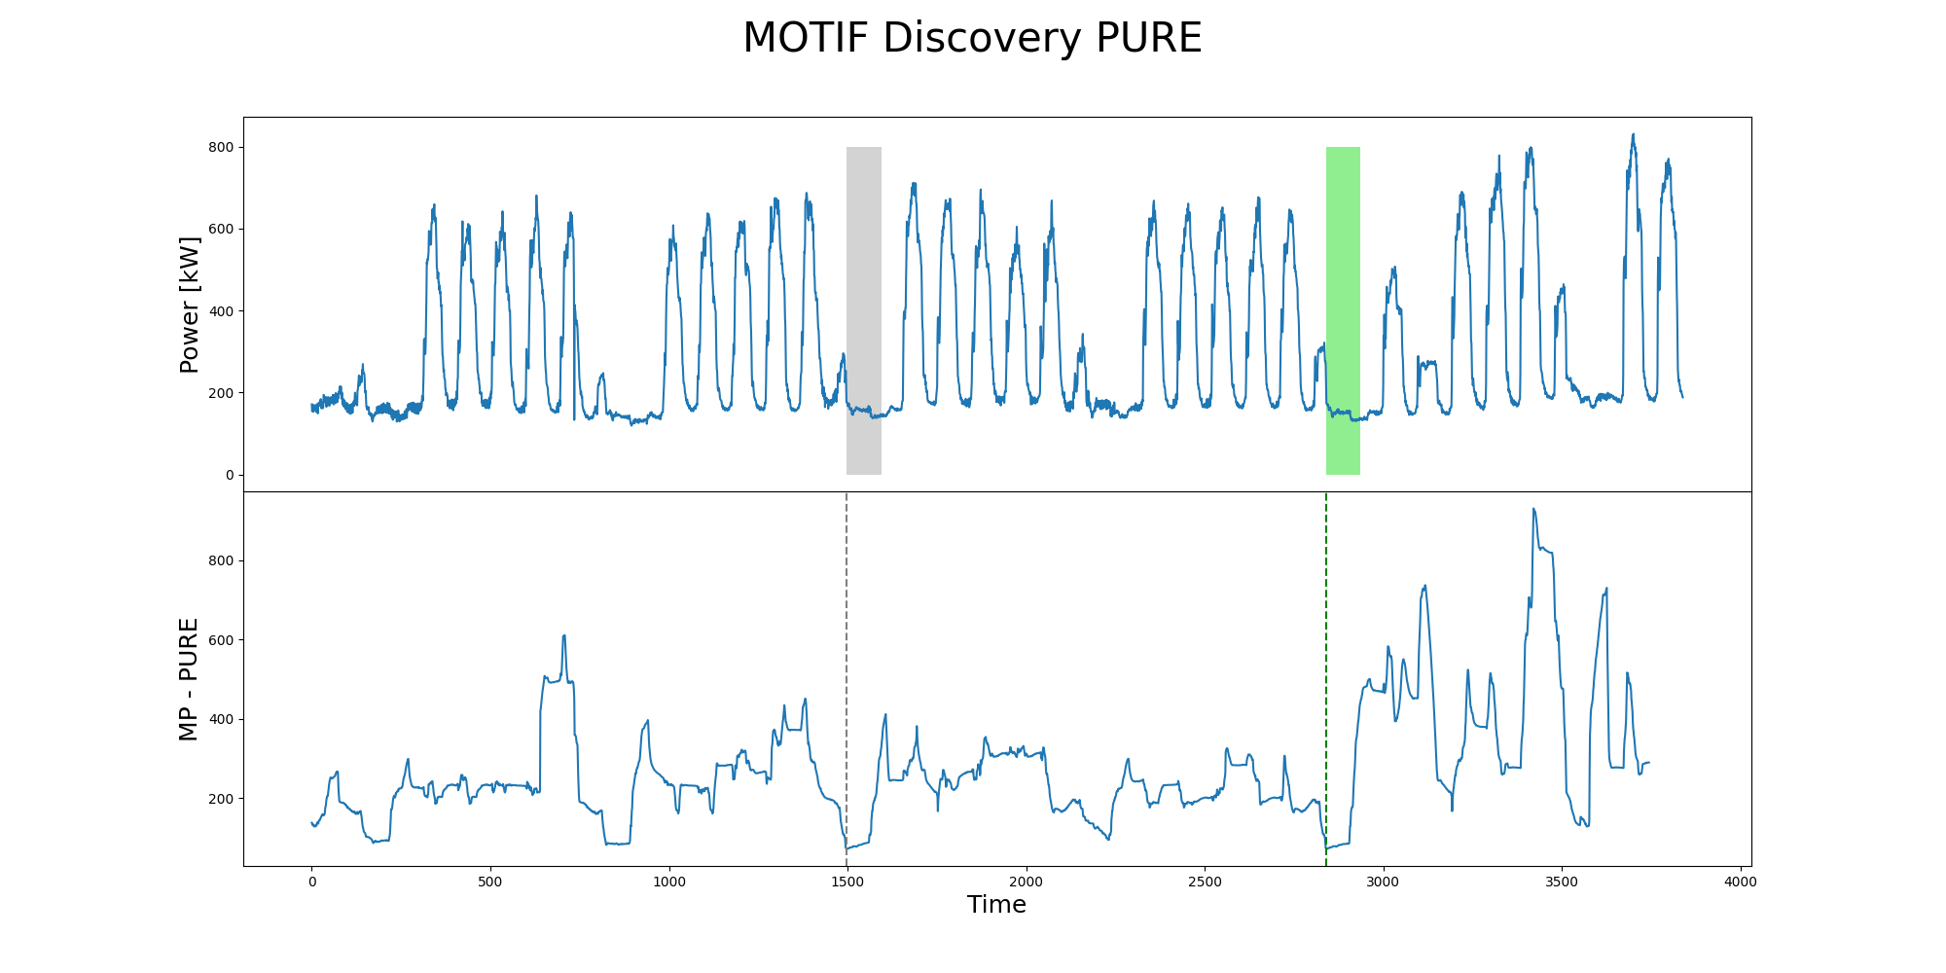
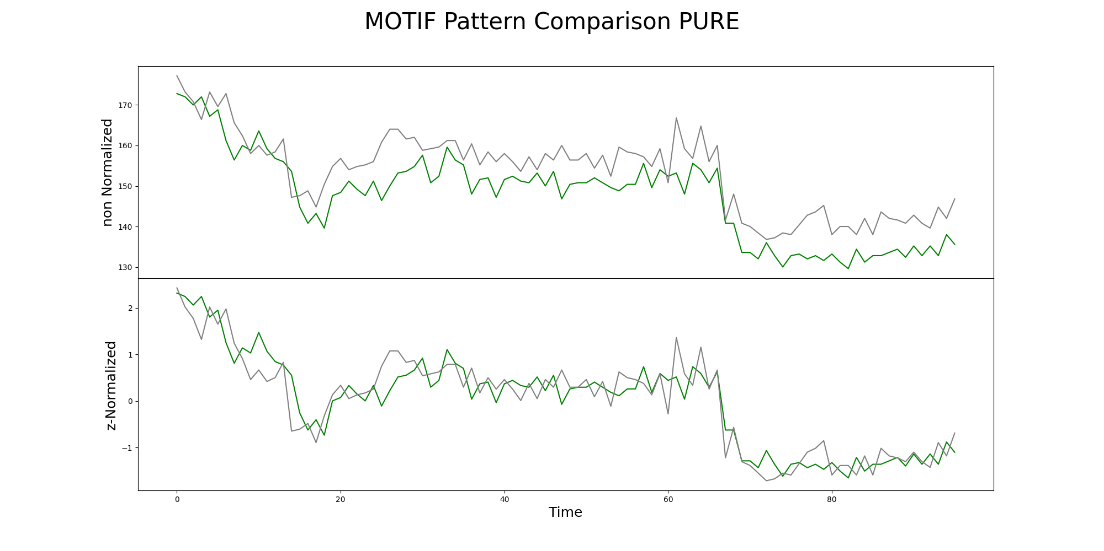
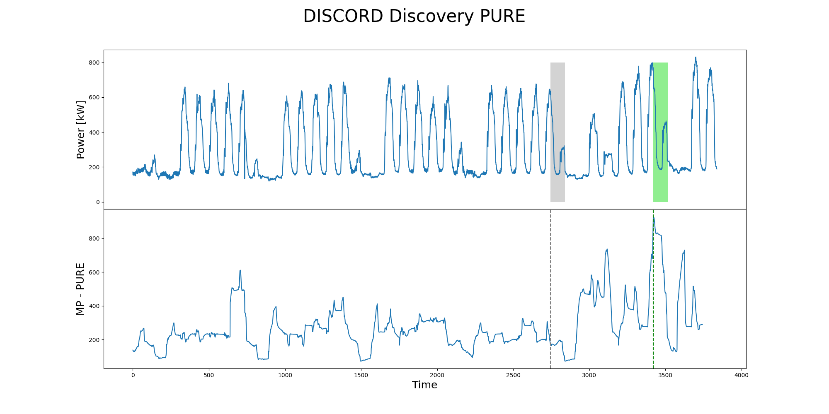
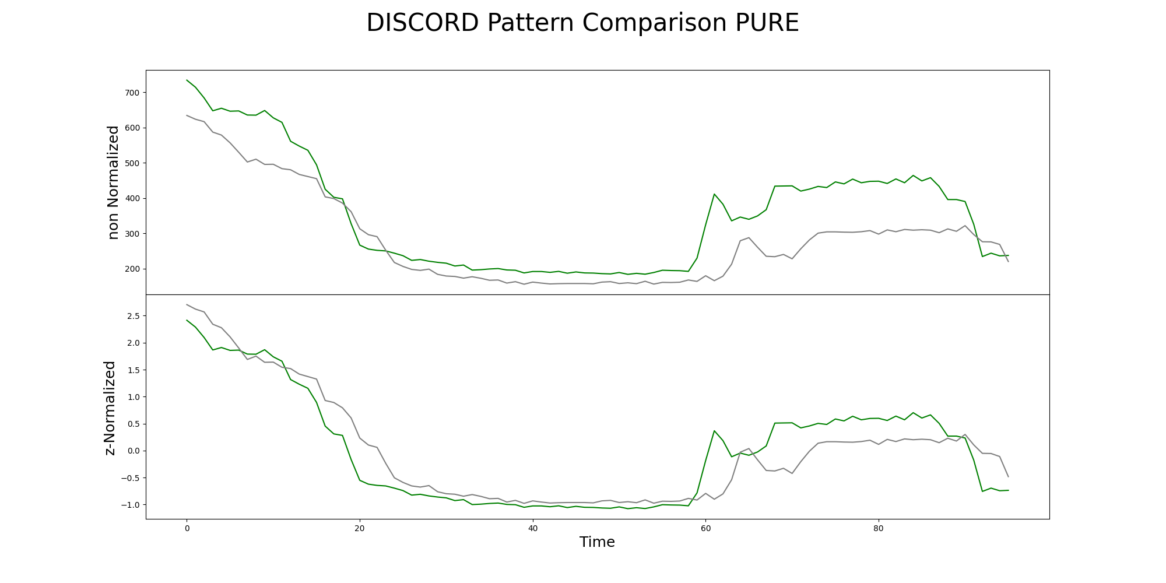
m = 96, n = 3765
T_{i,m}
1st NN

Slide 33
Limits of MP in energy field
In energy field the time series presents different periodicity (day, week, month, year) resulting different set of window size. The most interesting period is the daily one.
Problem: the MP does recognize weekend as discords (high values) -> discords will always be on weekend and motif during weekdays.
Possible solution: introducing expert knowledge, i.e. annotation vector when searching motif/discords
An energy anomaly not only consists into a different load shape but also different magnitude (same profile but higher electrical load).
Problem: The classic MP (with z-score normalization) may fail to identify these kind of anomaly while is effective in identifying anomalous shapes. MP searches NN based on shape similarity.
Possible solution: avoid z-score normalization of sub-sequences and use pure Euclidean distance

Slide 34
Open questions and possible research paths
Comparison with other techniques PAA SAX. MP does not loose information during the process, is it more effective in finding anomalies than dimensionality reduction methods?
Is there a way to overcame the z-score normalization issues in finding energy anomaly? Is the Euclidean distance more effective and which are the limitations?
Incorporate domain knowledge in motif/discord/sequence discovery (could be combined with 2)
To adapt the method in the energy field, makes sense to apply MP on detrended time series?
Automatic real time/streaming identification of motif discord. Fast and suitable for real time deployment online and continuous learning

Slide 35
Planned schedule
April
May
June
July
August
September
Conceptualization
Experimental test
Paper writing
Submission/revision
Periodical updates
30 June
15 July

Slide 36
References
Matrix Profile I: All Pairs Similarity Joins for Time Series: A Unifying View that Includes Motifs, Discords and Shapelets. Chin-Chia Michael Yeh, Yan Zhu, Liudmila Ulanova, Nurjahan Begum, Yifei Ding, Hoang Anh Dau, Diego Furtado Silva, Abdullah Mueen, Eamonn Keogh (2016). IEEE ICDM 2016.
Matrix Profile IIII: Using Weakly Labeled Time Series to Predict Outcomes. Chin-Chia Michael Yeh, Nickolas Kavantzas and; Eamonn Keogh. VLDB 2017 [pdf] Munich Germany.
Matrix Profile V: A Generic Technique to Incorporate Domain Knowledge into Motif Discovery. Hoang Anh Dau and Eamonn Keogh. [pdf] KDD'17, Halifax, Canada.
Matrix Profile VI: Meaningful Multidimensional Motif Discovery. Chin-Chia Michael Yeh, Nickolas Kavantzas, Eamonn Keogh. [pdf] ICDM 2017.
The Swiss Army Knife of Time Series Data Mining: Ten Useful Things you can do with the Matrix Profile and Ten Lines of Code. Yan Zhu, Shaghayegh Gharghabi, Diego Furtado Silva, Hoang Anh Dau, Chin-Chia Michael Yeh, Nader Shakibay Senobari, Abdulaziz Almaslukh, Kaveh Kamgar, Zachary Zimmerman, Gareth Funning, Abdullah Mueen, Eamonn Keogh.Data Mining and Knowledge Discovery
Discovering and Labeling Power System Events in Synchrophasor Data with Matrix Profile. Jie Shi, Nanpeng Yu, Eamonn Keogh, Heng (Kevin) Chen, Koji Yamashita. 2019 IEEE Sustainable Power & Energy Conference.
https://www.cs.ucr.edu/~eamonn/MatrixProfile.html

